Slide 1


ASFIP Foundation is a non-profit organization (501c 3), located in Atlanta. The Foundation was established as community outreach effort from the CFA Society Atlanta (an Atlanta CFA organization since 1960 with over 1600 members). ASFIP Foundation promotes financial literacy in the Atlanta community where CFA members work.

Slide 2

Invest in You
Manage Risks
Financial
Well-being
Live with Less
Invest for You
Our logo is made up of four “corner” pieces (or principles) which we like to think of as pieces of a frame
Our foundation tries to bring these principles to the community for improved financial well-being
We are helping individuals establish themselves with a plan for long term financial well-being

Slide 3
Live with Less
Live with Less
Budgeting
Pay Yourself First
Spending
Notes:
Learning to live with less is key to gaining financial security – we like to break living with less down to three components: Budgeting, Pay Yourself First, and Spending.
These three components work together to help you learn how to live with less.

Slide 4
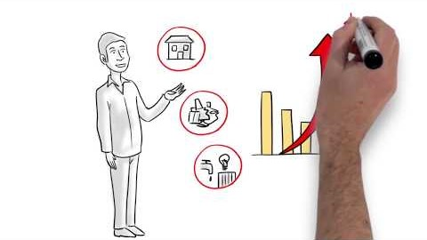
Live with Less – Budget
Play :50 through 3:00 for an example of doing a budget
Notes:
The first step of creating a budget is to WRITE it out
Writing your budget down makes it 60% more likely that you will actually follow your budget
Sharing your budget is even better – sharing a budget with a friend or family member gives you an 80% higher chance of following your budget = creates accountability

Slide 5
Live with Less – Budget
What you make (Income)
What you pay yourself (Savings)
What you spend (Expenses)
Golden Rule: ALWAYS SPEND LESS THAN YOU MAKE!
Notes:
There are certain basic principles that can make living a financially fulfilling life more attainable – don’t get overwhelmed if anything seems to tough to tackle, focus on what seems manageable and go from there.
Budgeting is important – it takes some effort at first, but eventually it will become second nature.
You start with what you make, income → the next priority is you, your savings is what you pay yourself, next come your expenses → Putting savings before expenses emphasizes the importance of this component
The golden rule seems intuitive, but credit cards and other types of debt have proven to make this an easy rule to break for a shockingly large number of Americans.

Slide 6
Live with Less – Budget
Begin the process of a budget and share with a friend for higher chance of success
GOOD = Writing a budget makes it 60% more successful
BETTER = Sharing a budget with a friend gives you an 80% greater chance of succeeding
Notes:
The first step of creating a budget is to WRITE it out
Writing your budget down makes it 60% more likely that you will actually follow your budget
Sharing your budget is even better – sharing a budget with a friend or family member gives you an 80% higher chance of following your budget = creates accountability

Slide 7
Live with Less – Budget
Guidelines for Life:
Needs
50%
Housing (25% max.)
Utilities
Wants
30%
New Shoes
Entertainment
Savings
20%
Retirement
Car and/or home fund
Food
Transportation
Dining out
Cable
Education (current and future)
Debt elimination (current and future)
Insurance
Notes:
You have to determine the most effective way to use your income; do you need a car or can you rely on public transportation.
Public transportation options should be a factor in your housing decision – it may be worth spending just a little more on housing if it means you can put off having a car for a while and save by not having to spend your income on a car payment, insurance, maintenance, and gas.
Our recommended breakdown is this: 50% for your Needs (i.e., what you need to live); 30% for your Wants (things that are nice to have, but not critical to your day-to-day life); and 20% for Savings.
Here are some examples of what falls in these categories, but you should customize your budget to fit your life.

Slide 8
Live with Less – Pay Yourself First
You pay yourself first by allocating 20% of your budget to savings!
Invest in yourself (e.g., skills and education) and your income will grow at an increasing rate
Pay yourself first so your priorities are being addressed
Spending controls are a key to reaching your goals, after your future is considered
Others may help you along the way but your plans should be to succeed on your own!
Notes:
Budgeting is how you create the plan, but your plan should start with YOU – that’s why you pay yourself first
Investing in you starts with paying yourself first – you set money aside not only for your future retirement, but to increase your value through investing in continuing education and other activities to enhance your professional value.
Investing in knowledge can pay off greatly. Not all continuing education costs money, you can find many online options that will allow you to develop skills for free. ToastMasters is an excellent way to enhance your public speaking skills, there are tons of chapters and membership is very affordable ($45 every 6 months).
To get certifications and degrees, you will likely need to spend money – but consider whether your employer has any programs you can take advantage of, e.g., tuition assistance.

Slide 9

Live with Less – Pay Yourself First
Play 2:00 through 3:05 to see an example of paying yourself first!
Notes:
The first step of creating a budget is to WRITE it out
Writing your budget down makes it 60% more likely that you will actually follow your budget
Sharing your budget is even better – sharing a budget with a friend or family member gives you an 80% higher chance of following your budget = creates accountability

Slide 10
Live with Less – Pay Yourself First
Payroll withdrawal or automatic transfers, the best discipline to success
Establish Emergency Fund - Potential cash flow concerns
  Save for unexpected accidents/ health issues
  Car repairs
  Lost or stolen items
Free Money
  Participate in Matching 401K to the maximum
  Use flexible spending accounts (i.e. HSA, Transportation) whenever possible
Develop a long term plan which reflects your values!
Notes:
Paying yourself first involves establishing an emergency fund – unexpected expenses are common and it is important to be prepared.
The rule of thumb is to try and have enough in your emergency fund to cover three months of your NEEDS (that is, basic living expenses). While three months of living expenses is a lot, keep in mind that it is a target and the key is to start early and set aside as much as possible until you reach that goal.
Building savings takes time, so try to have a long-term perspective when you think about your savings. While small contributions may not seem like much at the time, they will eventually start to add up.

Slide 11
Live with Less – Spending
Determine what is important to you and prioritize/ determine tradeoffs
  Want a Starbucks latte and muffin, vs coffee and cereal
  Mass transit versus owning a car
  Nicer phone or taking a trip
  Live alone or with room mates, or at home
  Go to school nights versus full time
  Obtain a professional designation (CFA) versus a graduate degree (MBA)
Notes:
After you have created your budget and spent sufficient time ensuring you pay yourself first, take a look at your spending
Start figuring out where you can make some cuts, this involves deciding what is important to you.
Think about whether you really need a new car or whether you could save money by relying on ride sharing services like Uber or Lyft for special trips and public transit for day-to-day transportation.
Students only have to pay $68 for unlimited monthly MARTA passes – that is likely less than you would spend on gas in a month
If you love living in town, then maybe consider how you can cut down in other areas to account for the generally higher cost of living (foregoing a car may be a good option if you live near a grocery store and can rely on public transportation)
Consider whether you really need a new phone or if you can use that money to do something that may be more rewarding – technology is advancing at an increasing rate and the newest phone will likely not be that new after 1 year

Slide 12
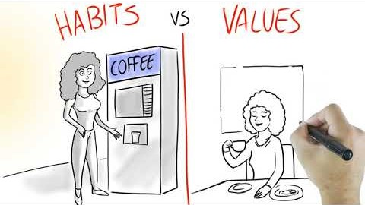
Live with Less – Spending
Play from 1:02 through 3:15 to get tips on controlling your spending!
Notes:
The first step of creating a budget is to WRITE it out
Writing your budget down makes it 60% more likely that you will actually follow your budget
Sharing your budget is even better – sharing a budget with a friend or family member gives you an 80% higher chance of following your budget = creates accountability

Slide 13
Live with Less – Spending
Adjust: Monitor Outcomes and Analyze Variances
Spending needs to match your priorities - Pay in cash for a month
  Establish envelopes for each bill, pay biggest bills and your needs first
  Every reach into your pocket will cause you to evaluate the decision
  Credit cards make spending easy, avoid making impulse purchases
  See how small items add up when you use cash!
Notes:
Reviewing and adjusting your spending is where your budget really comes to life. You have to ensure you are staying in line with what you established in your budget and make adjustments if you are not. If you are successful in sticking to your budget, consider increasing the amount you pay yourself first the next time you get a raise, bonus, or other income.
Change budget based on life events
Lost job – lower income, see if you can cut down on your Wants to avoid having to Pay Yourself less
Promotion – more money, more travel, more boarding for pets
Tax refund or bonus – put it towards your savings to give yourself a boost
Change expectations based on real life issues
Had major repairs due to a car accident that you paid out of pocket – staycation versus vacation
Take stock of what expenses are habits versus values (stopping every morning for coffee versus making coffee at home)
Moved home to take care of sick parent – contribute to food budget but use rent savings for condo down payment

Slide 14
Live with Less – Tips
Avoid bulk discount stores
Make breakfast at home, bring your lunch
Make credit the exception, not the rule
Tools: apps can be useful, but beware of fees & understand what personal information you are giving away
It is easy to spend more each month when using apps and not keeping track of actual spending
Notes:
Avoid bulk discount stores
Buy more than you need, overconsume
Waste is higher so benefit goes away
Make breakfast at home, bring your lunch
Important to have energy in morning, start out right
Control your calories and your portions while also helping your budget
Shop with a plan at beginning of the week, stick to the discipline
Make credit the exception, not the rule. Using credit is necessary to build a good credit score, but be conscious with your use. You don’t have credit card debt if you pay your balance in full every month.
Avoid quick decisions, they are usually the worst.
Understand sale process, items have conversion time (e.g., cars sell for cheaper at year end since carmakers and dealerships try to sell vehicles from the outgoing model year)
Sleep on decisions over $100, the same item will be there in the morning
Credit for emergencies, avoid store credit cards (the discounts are negated by high interest rates and overspending)
Pay credit card bill in full every month, avoids high interest charges
Apps – there are certain apps that will automate savings and monitor your spending. Some are free and some cost money. There are a lot of free banking options where you can manage your own savings and avoid potential fees.

Slide 15
Manage Risk
Manage Risk
Avoid Fraud
Emergency Fund
Credit
Notes:
Learning to live with less is key to gaining financial security – we like to break living with less down to three components: Budgeting, Pay Yourself First, and Spending.
These three components work together to help you learn how to live with less.

Slide 16
Manage Risks – Avoid Fraud

Slide 17

Manage Risk – Fraud
Play :45 through 3:15 for tips on Avoiding Fraud
Notes:
The first step of creating a budget is to WRITE it out
Writing your budget down makes it 60% more likely that you will actually follow your budget
Sharing your budget is even better – sharing a budget with a friend or family member gives you an 80% higher chance of following your budget = creates accountability

Slide 18
Manage Risks
Why should you be concerned about fraud?
  Online fraud is rising and so is the size of the damage
  Chips in credit cards have limited unlawful use but this switched the location of crimes to the internet
  If a thief steals your identity and begins racking up debt, it could take months, or years, to reverse the damage – better to protect yourself from it happening in the first place

Slide 19
Manage Risks
You expose yourself to fraud every time you:
  Give out your Social Security number
  Fail to check your bank account on a regular basis
  Enter payment information on unverified websites
  Click on links in an email from someone you don’t know
  Fail to freeze and monitor your credit reports
    http://clark.com/personal-finance-credit/credit-freeze-and-thaw-guide/

Slide 20
Manage Risk
Emergency Fund: What is it?
  Money set aside for use in the event of a personal financial dilemma, such as:
    Job loss
    Car repair
    Medical emergency (#1 cause of bankruptcy)
    Home repairs
  Currently 45% of the population don’t have $400 for an emergency and 60% don’t have $1000

Slide 21

Manage Risk – Emergency Fund
Play :37 through 2:45 for details on why an emergency fund is important and how to set it up
Notes:
The first step of creating a budget is to WRITE it out
Writing your budget down makes it 60% more likely that you will actually follow your budget
Sharing your budget is even better – sharing a budget with a friend or family member gives you an 80% higher chance of following your budget = creates accountability

Slide 22
Manage Risk
Emergency Fund: Why do you need it? Among, may other reasons:
  Provides flexibility in job search, so you don’t have to take the first opportunity that arises, which can have a huge impact on your future earnings power and future financial
  Unexpected health expenses are number one cause of bankruptcies!
  Provides contentment and peace of mind (decreases stress levels)

Slide 23
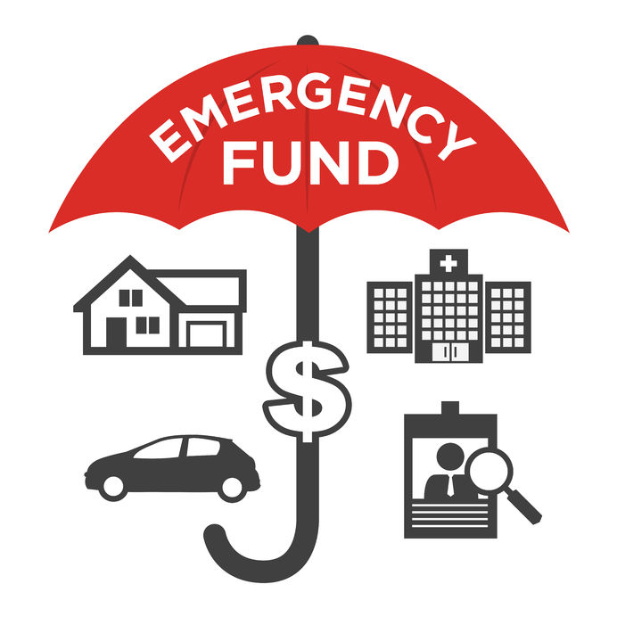
Manage Risk
Summary
    You will be far better prepared for those unexpected life events when you have an emergency fund to fall back on.
    Set it up at another online bank and forget about it
    Any money is better than none!(GET STARTED)

Slide 24
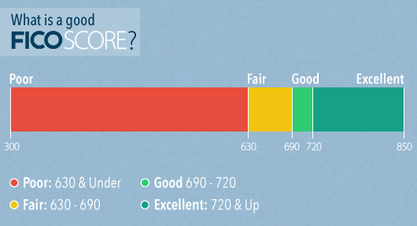
Manage Risk Credit and Debt
Credit Score = FICO score
  FICO does predictive analytics for three rating agencies
  Prepare data for ratings firms TransUnion, Experian and Equifax
  Scores range from 300 to 850 with higher being better!
  All aspects of financial wellbeing work together to produce good results

Slide 25
Manage Risk – Credit and Debt
Credit Score Components
  Manage your score like you do any grading system
  Attack the larger sections
  Automate payments
  Better scores leads to better rates on cars, insurance and homes!
  Understand it is your responsibility

Slide 26
Manage Risk
Payment History = 35%
  Most critical section, pay on time
  Ratings range from 1 – paid on time to 9 – in collections
  Automate payments whenever possible, ensures on-time payments, and declutters your life
  It takes time to get late or missed payments off so prevention is the key
  Pay off higher rate cards first
https://www.takechargeamerica.org/ This non profit works to restructure debt and move towards financial wellbeing

Slide 27
Manage Risk
Amount of Debt = 30%
  Score based on Revolving Utilization (i.e. All card limits = $2000 and using $500 would give you utilization of 25%)
  Get the number down as low as possible, guideline is always below 30%
  Ask to increase your limit so that the score improves
  Length of History = 15%
  Only way to build a history is be patient, take your time
  History improves with each loan paid off (car loans, student debt)
  Attack your debts in order of highest interest rate to lowest first, while ensuring minimum payments can be satisfied
    Credit cards typically have a higher interest rate than student debt.
  Automate some payments and use extra at end of month to accelerate

Slide 28
Manage Risk
New Credit = 10%
  Paying off credit and ability to add new credit builds record
  Only add credit to satisfy goals and when you can easily cover it
  Credit Mix = 10%
  Mixes of installment and revolving debt
    Revolving = Credit cards; Installment = Student Loans, Auto Loans, etc.
  Strong installment debt history will make future debt have lower rates and better terms!

Slide 29
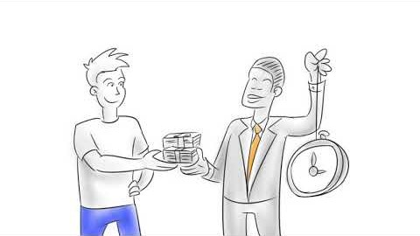
Manage Risk – Credit
Play :45 through 2:45 for tips on how credit scores can be improved!
Notes:
The first step of creating a budget is to WRITE it out
Writing your budget down makes it 60% more likely that you will actually follow your budget
Sharing your budget is even better – sharing a budget with a friend or family member gives you an 80% higher chance of following your budget = creates accountability

Slide 30
Manage Risk
Debt-to-Income Ratio
  Key component of your credit health
  Includes housing, auto, student loans, and credit card
  43% is a key guideline for your debt to income ratio. As a portion of your income try to keep to the following:
  Housing 28% max; lower is better
  Car loans 10% max; look at various commuting options
  Credit Cards 5%; with goal of paying 100% every month
https://www.credit.com/debt/debt-to-income-ratio/ Consumer Financial Protection Bureau has a wealth of free resources on their website

Slide 31
Manage Risk
Summary
    Credit and debt should be utilized carefully
    Rule regarding debt for college:
      Total debt less than Expected Starting Salary
    Put yourself in position to succeed by managing your FICO score
    Automate payments below some level ($150) to simplify your life and strengthen your scores, and secure your financial future!
https://www.consumer.ftc.gov/articles/0150-coping-debt The Federal Trade Commission webpage shares tips on debt management

Slide 32
Thanks to all our sponsors and volunteers for making this possible
Thanks to CFA Atlanta for support and inspiration as we move forward
Thanks to the CFA Institute for support and educational material
Check out our whole series of videos on YouTube
Follow ASFIP Foundation on LinkedIn, FB, Insta & Twitter
Online: CFAAtlanta.org/Foundation
Email: Foundation@CFAAtlanta.org

